Slide 1
THE FATHERLESS FACTOR
LUKE 10:29-37

Slide 2
REACHING FATHERLESS FAMILIES
Spreading Awareness
Creating Unique Resources
Speaking
Partnering with Local Churches
Establishing Local Single Mom Support Groups

Slide 3
SPREADING AWARENESS
SOCIAL MEDIA - TV - RADIO - CHURCHES COLLEGES - SEMINARIES - CONFERENCES

Slide 4
SPREADING AWARENESS
LET’S TALK ABOUT FATHERLESSNESS SHOW

Slide 5
UNIQUE RESOURCES

Slide 6
SPEAKING
PRISONS - YOUTH DETENTION CENTERS - PUBLIC & CHRISTIAN SCHOOLS - CONFERENCES - CAMPS

Slide 7
PARTNERING WITH LOCAL CHURCHES IN FATHERLESS MINISTRY
UNDERSTAND AND EFFECTIVELY MINISTER TO:
FATHERLESS CHILDREN
MENTORING
SINGLE MOMS
FATHERLESS TEEN GIRLS
FATHERLESS TEEN GUYS
GRANDPARENTS RAISING THEIR GRANDCHILDREN

Slide 8
PARTNERING WITH LOCAL CHURCHES IN FATHERLESS MINISTRY
THE GOD IS MY DAD NETWORK

Slide 9
SINGLE MOM
COMMUNITY GROUPS
GOAL: 1 MINISTRY IN EVERY COUNTY

Slide 10
THE FATHERLESS FACTOR
LUKE 10:29-37

Slide 11
29 But he, willing to justify himself, said unto Jesus, And who is my neighbour?
30 And Jesus answering said, A certain man went down from Jerusalem to Jericho, and fell among thieves, which stripped him of his raiment, and wounded him, and departed, leaving him half dead.
31 And by chance there came down a certain priest that way: and when he saw him, he passed by on the other side.
LUKE 10:29-37

Slide 12
32 And likewise a Levite, when he was at the place, came and looked on him, and passed by on the other side.
33 But a certain Samaritan, as he journeyed, came where he was: and when he saw him, he had compassion on him,
34 And went to him, and bound up his wounds, pouring in oil and wine, and set him on his own beast, and brought him to an inn, and took care of him.
LUKE 10:29-37

Slide 13
35 And on the morrow when he departed, he took out two pence, and gave them to the host, and said unto him, Take care of him; and whatsoever thou spendest more, when I come again, I will repay thee.
36 Which now of these three, thinkest thou, was neighbour unto him that fell among the thieves?
37 And he said, He that shewed mercy on him. Then said Jesus unto him, Go, and do thou likewise.
LUKE 10:29-37

Slide 14
OVER 30 MILLION FATHERLESS IN THE US.

Slide 15
THREE STEPS TO REACH FATHERLESS FAMILIES AROUND YOU:
REJECT
REMIT
REACT WITH A

Slide 16
REJECT APATHY
VS. 30-33A
REMIT

Slide 17
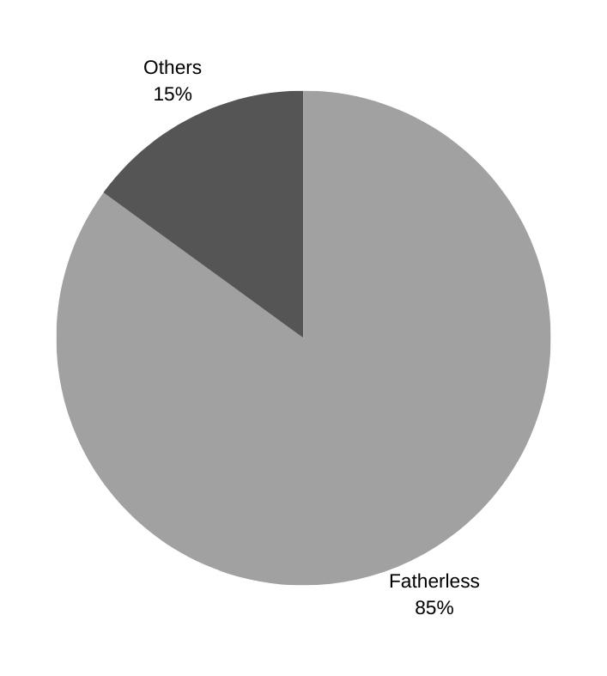
CRIME
“85% of youths in prisons grew up in a fatherless home.”

Slide 18
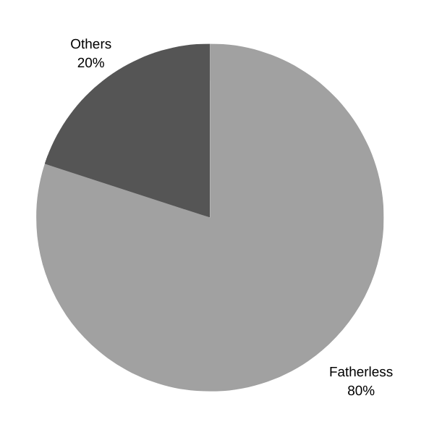
RAPISTS
“80% of rapists motivated with displaced anger come from fatherless homes.”

Slide 19
MASS SHOOTERS
26 OF 27
"Of 27 Deadliest Mass Shooters, 26 of Them Were Fatherless"

Slide 20
HOMOSEXUALITY
“I have worked with thousands of homosexuals. I have never seen a homosexual who had a loving respectful relationship with his father.”
DR. JOSEPH NICOLOSI

Slide 21
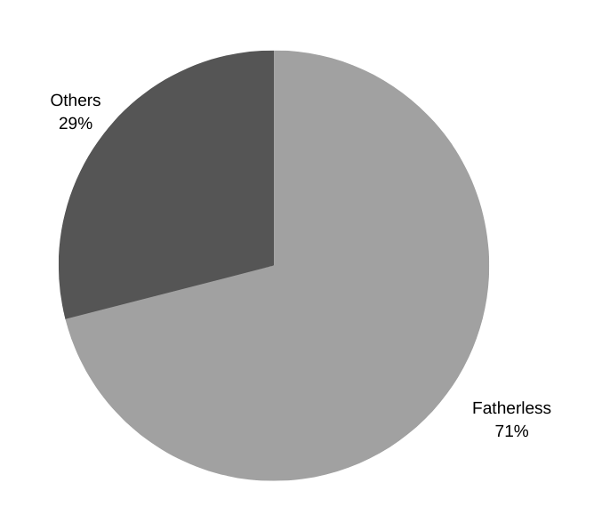
TEEN PREGNANCY
71% of pregnant teenage girls come from a fatherless home."
USDHHS

Slide 22
TEEN PREGNANCY
“A white teenage girl from an advantaged background is five times more likely to become a teen mother if she grows up in a single-mother household than if she grows up in a household with both biological parents.”

Slide 23
EDUCATION
“In studies involving over 25,000 children using nationally representative data sets, children who lived with only one parent had lower grade point averages, lower college aspirations, poor attendance records, and higher dropout rates than students who lived with both parents.”

Slide 24
SUICIDE
“Three out of four teenage suicides occur in households where a parent has been absent.”

Slide 25
ADDICTIONS &
MENTAL ILLNESS
“Fatherless Children are at a dramatically greater risk of drug and alcohol abuse, mental illness, suicide, poor educational performance, teen pregnancy, and criminality.”
USDHHS

Slide 26
REMIT COMPASSION
VS. 33B

Slide 27
EXODUS 22:22
"Ye shall not afflict any widow, or fatherless child."

Slide 28
JOB 29:12
"Because I delivered the poor that cried, and the fatherless, and him that had none to help him."

Slide 29
PSALM 68:5
"A father of the fatherless, and a judge of the widows, is God in his holy habitation."

Slide 30
PSALM 146:9
"The LORD preserveth the strangers; he relieveth the fatherless and widow: but the way of the wicked he turneth upside down."

Slide 31
JAMES 1:27
“Pure religion and undefiled before God and the Father is this, To visit the fatherless and widows in their affliction, and to keep himself unspotted from the world.”

Slide 32
REACT WITH A PLAN
VS. 34-37

Slide 33
THREE STEPS TO REACH FATHERLESS FAMILIES AROUND YOU:
REACT WITH A PLAN
REJECT
APATHY
REMIT
COMPASSION

Slide 34
JESUS SAID:
“GO, AND DO
THOU LIKEWISE!”
YOUR CHALLENGE:
MAKE A PLAN!
DO SOMETHING!

